Slide 1


Music Player Using Python
Meghwin Dave
Richa Modi
22002171220009
22002171220083
Rajat Patel
Vedansh Taraviya
Krut Dharsandia
22002171220090
22002171220099
22002171220011

Slide 2
Table of contents
01
02
03
04
Project Description
Workflow
Directions to use the software
What our project is.
Libraries
Used
Demo
Of GUI
Python libraries being used in creation of music player
How the music player looks.

Slide 3
What our project is...
01
We created an mp3 music player in which we can play the song, pause it, resume it, and navigate from the current song to the next song as well as previous songs.
We used Python and its libraries. The first library that we used is Tkinter which is a widely used GUI library offered by python, we do not have to install it separately, as it comes with python itself.

Slide 4
Workflow
02
Open GUI
Play
Run the program
Select songs from list
Tap open
Enjoy.
Select a folder containing songs
Dance on the beats of your favourite songs

Slide 5
Libraries Used
03
Window Geometry
Sizing of GUI
tkinter
Song Label
To display name of songs
Python
Libraries
Mixing Songs
Playing songs on clicks
pygame
Play, Pause, Stop
Song actions

Slide 6
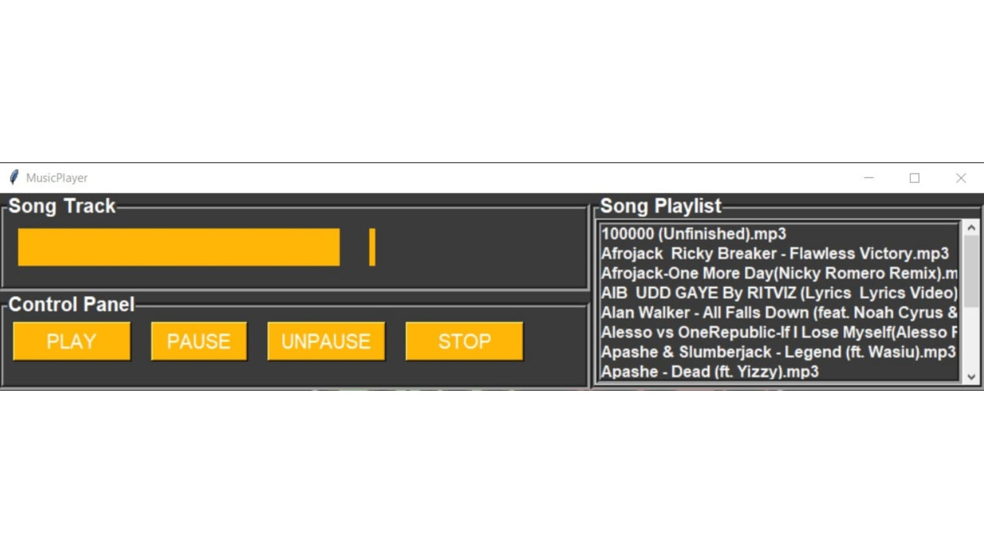
A Demo
04
This is how the GUI of our music player looks like

Slide 7
Thanks!
Do you have any questions?

